Slide 1
CONCEPT OF SUSTAINABLE LAND MANAGEMENT
Sustainable land management has been defined as “a system of technologies and planning that aims to integrate ecological with socio-economic and political principles in the management of land for agricultural and other purposes to achieve intra and international equity”. SLM IS THUS COMPOSED OF THE THREE DEVELOPMENTs technology, policy and land use planning.
Land degradation is a central challenge to sustainable development.
Sustainable development defined as a development that “meets the needs of the present without compromising the ability of future generations to meet their own needs”.
The concept of sustainable land management (SLM) offers solutions that go beyond technologic recommendation by including aspects of social participation and policy dialogue.

Slide 2
GLOBAL PROBLEM ASSOCIATED WITH LAND DEGRADATION
At the global scale, key problems threatening natural resources and the sustainability of life support systems are:
1) Soil degradation,
2) Reducing source of water
3) The loss of biodiversity
These problem occur in virtually all socio-cultural and economic context worldwide.

Slide 3
EFFECTS OF LAND DEGRADATION ON NATURAL RESOURCES
Problem of land degradation exist in many parts of the world. The following natural resources may be affected:
1) Soil: About one third of the world’s agricultural land has been damaged, mostly by soil loss caused by water erosion.
2) Water: Problems of quality and quantity, as well as spatial and temporal interdependence (highland-lowland effects)
3) Natural vegetation of quality, quantity and biodiversity
4) Wildlife: Problems of protected areas, wildlife corridors, controlled hunting and poaching.

Slide 4
PATTERN OF PROBLEMS
The perception of these problems, however, varies greatly-between land users and other stakeholders, among these groups, and with time.
From an economic perspective, e.g. Environmental problem
Social perspective: may take account of poverty issues, social differentiation of affected groups and political effects, but disregard economic considerations.
But only the ecological perspective may consider only the effect of land degradation on nature, e.g. wildlife, vegetation and ecological processes.

Slide 5
FEW TYPICAL LAND DEGRADATION CASE STUDIES EXAMPLE

Slide 6
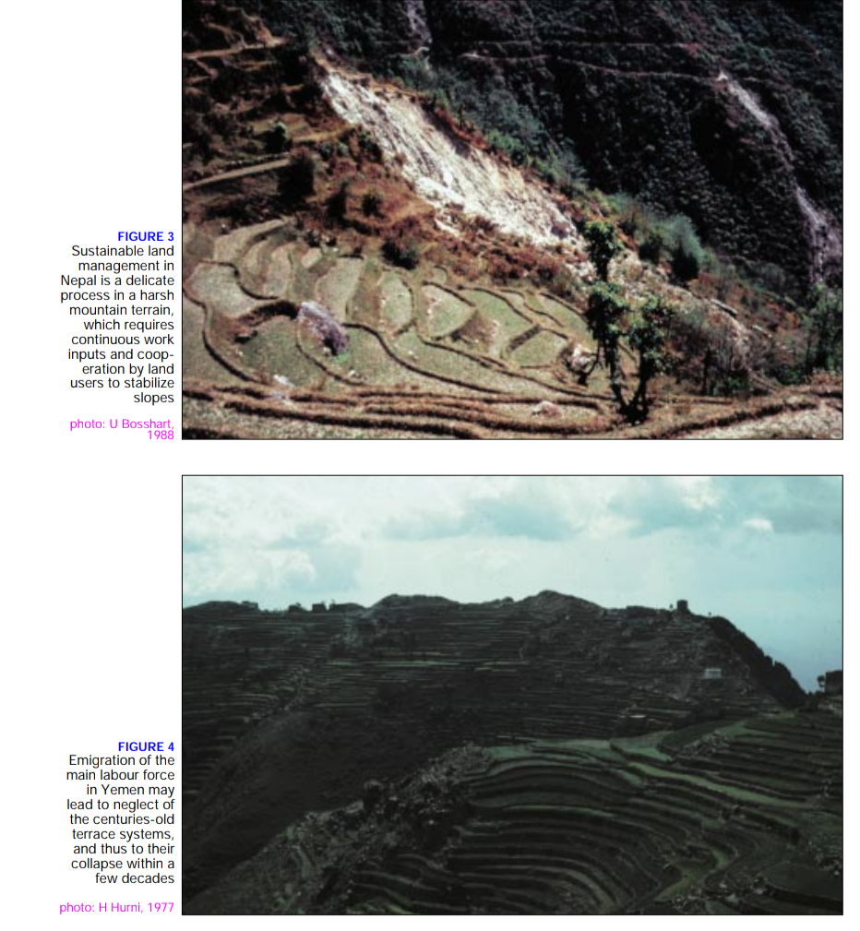

Slide 7
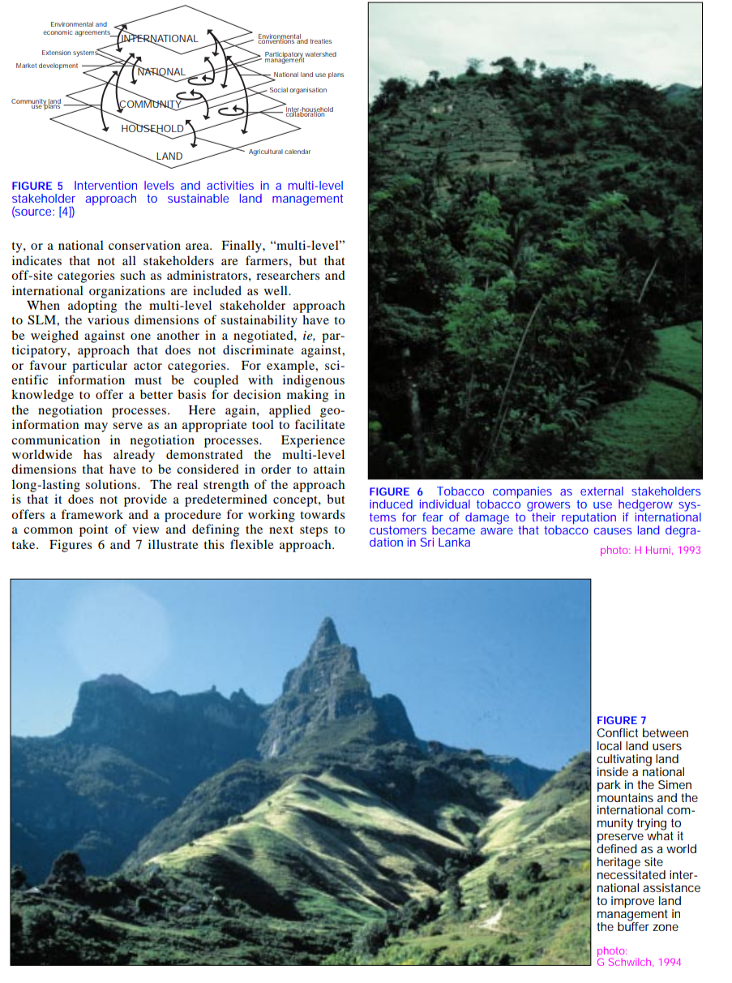

Slide 8
HOW TO MANAGE LAND RESOURCES
Natural resources can potentially be used in a sustainable way if appropriate land management technology, regional planning and the policy framework complement one another in a purposeful way, in accordance with the principles and concept of sustainable land management.
At the center of this thinking is the concept of “ecosystem balance”.
It is here that the relevance of geo-information to SLM Can be seen.

Slide 9
continued
Knowledge
Scientific approach
Economic, political and power structure
If geo-information is to assist in improving the sustainable use of natural resources, it must have four major orientations.

Slide 10
A new approaches to sustainable land management
A “multi-level stakeholder approach to sustainable land management” has been developed for finding feasible, acceptable, viable and ecologically sound solutions at local scales.
Today, many international programmes and bilateral cooperation projects have started.
“Management” is defined as an activity on the ground, using appropriate technologies in the respective land use system.

Slide 11
Continued
A technology follow five major pillars of sustainability, namely:
1) Ecologically protective
2) Socially Acceptable
3) Economically productive
4) Economically Viable
5) Reduce risk

Slide 13
Traditional knowledge and bio diversity conservation

Slide 15
